Slide 1
University of Southampton
Notes:
Links to open in case of questions:
https://www.textboxdigital.com/described-categories
https://www.textboxdigital.com/focus-locus-method
http://diagramcenter.org/table-of-contents-2.html
https://www.nwea.org/content/uploads/2022/02/Image-Description-Guidelines-for-Assessments_NWEA_2021.pdf

Slide 2
What is alternative text? How do I write it for images, charts, and graphs?
Office 365 Community
19 May 2022
Notes:
Hello and happy global accessibility awareness day! “What is alternative text and how do I write it for images, charts and graphs”?

Slide 3
Today’s topic
Images
What is alternative text?
Structure
Sensory characteristics
Colour
Accounting for colour-blindness.
Platforms and tools
Accessible kiosk displays.
Writing alternative text for
Images
Planning your accessible site
Accessibility considerations for social media
Apps for accessibility
Charts and graphs best practices.
Dyslexia friendly colour choices.
Words that you can read - the importance of contrast.
Charts and graphs
Notes:
That’s our topic for today, the first half is about images in general, and then I will cover charts and graphs after a question break.
This presentation is part of…

Slide 4
Accessibility in under ten minutes
Images
What is alternative text?
Structure
Why are headings and structure important?
Sensory characteristics
Get down with clear language.
Colour
Accounting for colour-blindness.
Platforms and tools
Accessible kiosk displays.
Writing alternative text for
Images
Charts and graphs
Infographics
Heatmaps
Using headings in word.
Making your table accessible
What is reading order in PowerPoint?
Don't "click here" - how to write good links.
Charts and graphs best practices.
Dyslexia friendly colour choices.
Words that you can read - the importance of contrast.
Planning your accessible SharePoint site
Accessibility considerations for social media
Apps for accessibility
Notes:
Our “accessibility in under ten minutes” series.

Slide 5
What is alternative text? 1
It’s also known as “alt text”.
The written copy that appears in place of an image.
It helps those who do not see the image to understand the meaning of the image within the context of its use.
Those who use a screen reader.
Notes:
You may also hear alternative text shortened to “alt text”.
[Progress]
It’s the written description of an image that we write for those who do not see it.
[progress]
Helping them to get the intended meaning of that image. This might be those with visual impairments who use a screen reader, an assistive technology that speaks aloud what is on screen.

Slide 6
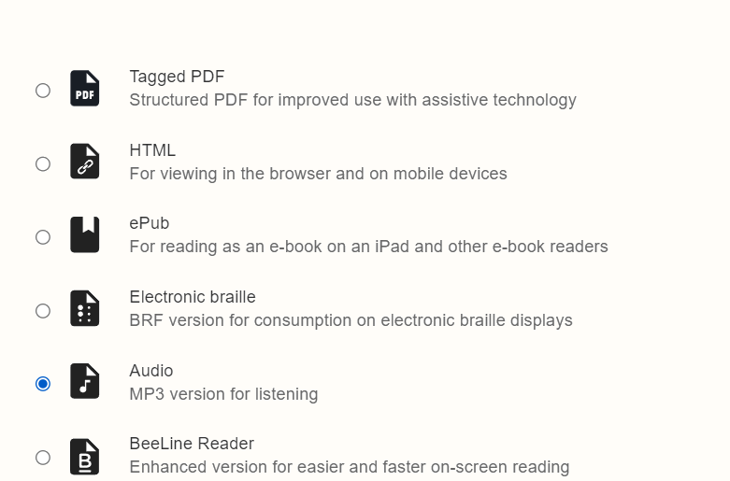
What is alternative text? 2
It’s also known as “alt text”.
The written copy that appears in place of an image.
It helps those who do not see the image to understand the meaning of the image within the context of its use.
Those who use alternative formats.
Notes:
Alternative text benefits those who personalise their learning experience using Blackboard’s alternative formats, such as the audio version. Since these became available last July, more than 14,000 of our students have generated alternative formats.

Slide 7
What is alternative text? 3
It’s also known as “alt text”.
The written copy that appears in place of an image.
It helps those who do not see the image to understand the meaning of the image within the context of its use.
Those who use alternative formats.
Notes:
Those who listen to content rely on alternative text being provided for images, otherwise they’ll miss out on important details.

Slide 8
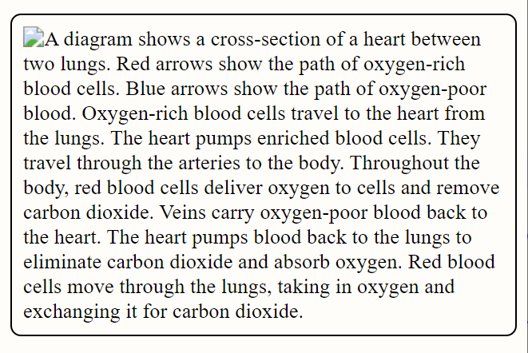
What is alternative text? 4
It’s also known as “alt text”.
The written copy that appears in place of an image.
It helps those who do not see the image to understand the meaning of the image within the context of its use.
Those for whom images do not appear.
Notes:
Alt text also appears when an image link is broken, or users have turned off images.
Those on pay as you go internet may disable images on web pages in order to save bandwidth or data costs, if alt text has been added they won’t miss out.
This text is for reference, not to be used.
In order to preserve digital equity it’s important to add alternative text so that such students are not excluded.

Slide 9
Without alternative text
Notes:
When we don’t add alternative text to images we’re creating a barrier for those who don’t see them.

Slide 10
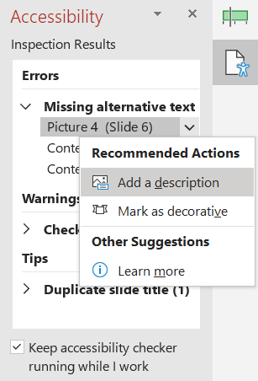
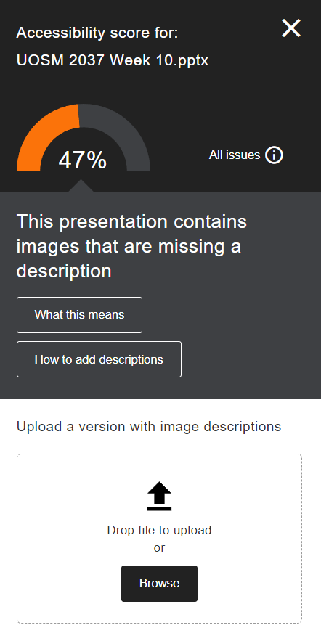
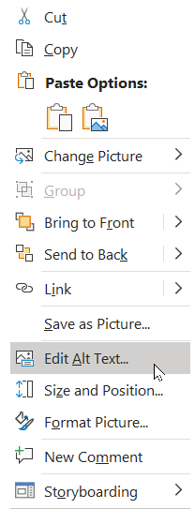
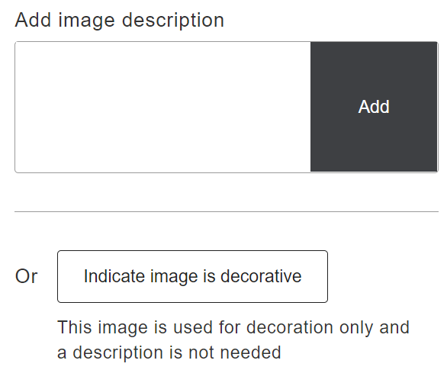
Where might you add alternative text?
When you create documents and presentations.
PowerPoint
Word
When you create web-based resources.
SharePoint
WordPress
Notes:
We’re likely to add alt text in documents, presentations, and web sites.
[progress]
Both Blackboard and Office can alert you to missing alternative text so we can fix it. If Images are used only for visual interest I can mark them as decorative.

Slide 11
Adding alternative text
Notes:
To add alt text we usually select an image and use the alt text button. It gives us a box in which to write our description and an optional checkbox to mark the image as decorative if it is only being used to provide visual interest.

Slide 12
What to consider
Context
Descriptions of the same image will vary depending on the context.
Audience
Who is your target reader?
Function
What is the purpose of the image?
Source: Diagram Center
Notes:
When we write alt text we should consider the context in which we use the image, our intended audience, and the function or purpose of that image.
Below is detail for reference but not for use in presentation.
The context in which you use an image will affect the description. Is it an image used in an introductory session, or the focus of a detailed article? Is the image used as an example, or are you using it for a specific purpose? Will you be asking students or colleagues to use the image in someway? What would you expect someone who can see the image to take away from it? Context is so important. It’s unlikely that you can use the same alternative text for an image used in different contexts.
Consider your audience. Is it for the general public, primary school children, or final year undergraduate students? What prior knowledge do you expect them to have? How much detail do they need?
In terms of function we mean why are you using this image? Are you using the image just for decoration, to bring balance and flavour to content?

Slide 13
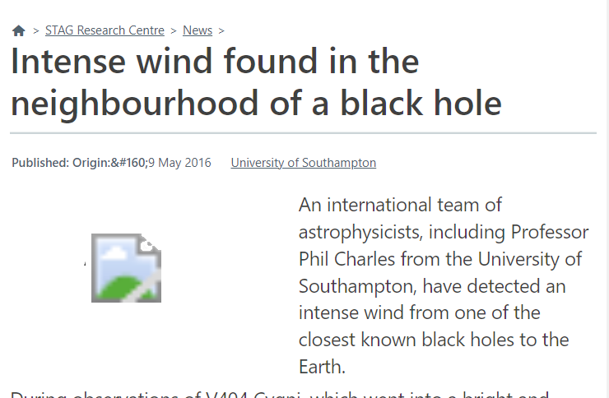
To put it another way…
What would be lost if the reader could not see the image?
How would you describe the image over the telephone?
Article source: Southampton Theory Astrophysics and Gravity (STAG) Research Centre
Notes:
Another way to think about how to write alternative text is what would be lost if the reader could not see an image [progress]
Or how would we explain the image over the ‘phone to someone who does not see it?

Slide 14
Three worked examples
Notes:
To show you what we mean we’re going to use three worked examples.

Slide 15
Example 1
Context | Audience | Function
Tourist brochure | General public | Example of historic landmarks
Alternative text:
“The Bargate is a medieval gatehouse in the city centre of Southampton”
Image source: Wikipedia CC-BY-SA 4.0
Notes:
Our first example is a photograph of Southampton’s Bargate. This is a famous point of interest in Southampton’s city centre. In the photo is an old historical building, looking a little incongruous in front of its urban background, on a clear sun-lit day.
Our context is we will use this photo in a tourist brochure, aimed at the general public, as an example of an historic landmark in Southampton.
The alternative text I chose is “The Bargate is a medieval gatehouse in the city centre of Southampton”. I think this is all that’s needed within this context, considering the audience and function.
I did not say “Photo of the Bargate”, usually we don’t need to describe the format unless it’s important to the context, audience or function.
I didn’t describe the weather, or the background. I didn’t detail other aspects of the Bargate as those are not necessary for this context.

Slide 16
Example 1 part 2
Context | Audience | Function
Medieval gate houses of England | Historians | Within a group of examples.
Alternative text:
“Southampton Bargate. Constructed in 12th Century of stone and flint with arrow slit windows.”
Image source: Wikipedia CC-BY-SA 4.0
Notes:
If I was using this image in an article about English medieval gate houses then I may give more detail. Here I’ve used “Southampton Bargate. Constructed in 12th Century of stone and flint with arrow slit windows.”
I’m not a historian myself so this description is just my idea of a more detailed alternative text which I imagine may give historians more appropriate information within this imaginary context.
Alternative text should be written by subject matter experts, this is especially so where the context and audience will also be subject matter experts, or those studying in that area.

Slide 17
Example 2
Context | Audience | Function
Negotiation skills | Staff | Visual interest
Alternative text:
Mark as decorative
Image source: iStock
Notes:
Our next example is a stock photo of two white people shaking hands. While we only see their hands and forearms they appear to be men wearing business attire over 40 years of age.
The context is an article about negotiation skills, aimed at staff.
The image provides no value other than visual interest and so we will mark it as a decorative image. This means it will be ignored by screen readers and the audio alternative format in Blackboard.
Alternatively, if I were writing an article about the lack of diversity in stock photo services and using this image as an example then I might add alt text describing the ethnicity, gender, and attire we infer from the image.
___
The internet has become a very visual medium, we almost expect to have some visual interest or flair on a page or in a document to make it more appealing and to break up the content, we don’t need to add alternative text for images that are only used for that purpose, but it is important to mark them as decorative. Doing so prevents those who listen to the content from wondering what they are missing.

Slide 18
Example 3
Context | Audience | Function
Explaining photo-synthesis | School children | Simple diagram
Alternative text:
“Process of Photosynthesis. A plant, growing out from earth is at the centre. The sun is in the sky and is labelled “Light energy”. The plant takes in water through its roots, carbon dioxide and sunlight through its leaves. The leaves release oxygen into the air and generate sugars as part of the process.”
Image source: iStock
Notes:
Our third example is a simple diagram of the process of photosynthesis aimed at school children.
With diagram descriptions we start with the title, then consider the basic structure of the image and what’s important. The colours are not important, nor are the clouds or the texture of the earth or how many roots are shown. We do not need to describe the arrows themselves.
The alternative text I have chosen is “Process of Photosynthesis. A plant, growing out from earth is at the centre. The sun is in the sky and is labelled “Light energy”. The plant takes in water through its roots, carbon dioxide and sunlight through its leaves. The leaves release oxygen into the air and generate sugars as part of the process.”
This alternative text is quite long. If the original article already described this process I would mark the image as decorative and use a caption to describe the essential content, which may only be the title of the image.
____
Speaker note
I removed the chemical notation e.g. CO2 etc. If I felt it was important to include them I would separate some letters out, for example C space O space 2 Otherwise a screen reader would read out “CO 2”. Some screen readers like NVDA will read out a subscript number as a normal number and some will ignore them, so for alt text it can be better to write them how they sound.

Slide 19
What’s the difference between captions and alternative text?
Captions
give a general idea of what the image is about, but they do not describe it in detail. May include an image attribution or a title.
Alternative text
describes exactly what can be seen in an image based on its context, audience, and function.
Notes:
What’s the difference between captions and alternative text?
Captions give a general idea of what the image is about, but they do not describe it in detail. They might include an image attribution or a title.
Alternative text, as we have hopefully demonstrated, describes exactly what can be seen in an image based on its context, audience, and function.

Slide 20
What’s the difference between captions and alternative text? 2
Caption:
Having an impact on patients’ lives in the clinic.
Alternative text
A doctor examines a patient’s eyes using a slit lamp ophthalmoscope.
Image source: Beating blindness, University of Southampton News
Notes:
This image and caption is taken from a University news article, “beating blindness”. The image shows a man in medical attire using some kind of apparatus to examine the eyes of a woman whose back is turned to us.
The caption, taken from the actual news article is, “Having an impact on patients’ lives in the clinic.”
Unfortunately the alternative text was the same as the caption. I reached out to Professor Andrew Lotery, who is featured in the original article, to help write alternative text for this image, which is “A doctor examines a patient’s eyes using a slit lamp ophthalmoscope.” Again, this shows it takes subject matter expertise to write accurate alternative text.
https://www.southampton.ac.uk/news/2022/04/beating-blindness.page

Slide 21
Summary
Like any communication there is subtlety and complexity. It’s unlikely anyone will write the same alternative text for the same image.
It’s easier to write alternative text as you go, rather than leaving it to the end.
Alternative text should be written by a subject matter expert.
We covered simpler images today. There are other techniques for more complex images. We will cover these in a future session.
Notes:
Keep in mind that writing alternative text is a form of creative writing. As long as you are conveying information that is relevant and in context then you’re on the right track.
[progress]
To write accurate alternative text you need subject matter expertise.
[progress]
We usually find it more efficient to write alternative text as we go, rather than adding it all at the end when it may be missed.
[progress]
We covered quite simple images so far. There are techniques for more complex images like charts and graphs that we will cover next.
_____
We usually find it more efficient to write alternative text as we go, rather than adding it all at the end when it may be missed. However another way of looking at
writing alt text is as a useful way of checking your images, that they are relevant and conveying what you want them to, by adding alternative text at the end of creating a resource it could be another way of editing and checking your content.

Slide 22
Feedback
“I have had students and friends say that the inclusion of alternative text on pictures has helped them feel included and also to trust the tutors that they are prepared to put effort in to make their materials more accessible, which in turn helps them feel confident to ask for help in the future… ”
Devin Valentine Learning Support Advisor University of Southampton
Notes:
Devin Valentine, a Learning Support Advisor at the University of Southampton, says “I have had students and friends say that the inclusion of alternative text on pictures has helped them feel included and also to trust the tutors that they are prepared to put effort in to make their materials more accessible, which in turn helps them feel confident to ask for help in the future… ”

Slide 23
What did we cover in the last five minutes?
What is alternative text?
Where do we use it?
What to consider when we write alternative text
Three worked examples
Captions vs alternative text
What next?
Notes:
Today we explained what alternative text is, where we might add it, and we should consider when writing it, through providing three worked examples.
We discussed the difference between captions and alternative text, and gave some suggestions for what to do after this session to go further on your accessibility journey.

Slide 24
Questions and Answers
Notes:
Before we look at charts and graphs. Please raise you hand in the chat and we will come to you for your questions.
_____
Paste these links which have been used in the chat
Turn on accessibility checking as you go in office: https://elearn.southampton.ac.uk/accessibility/check365/
POET Tool: https://poet.diagramcenter.org/
Book an accessibility one to one: https://outlook.office365.com/owa/calendar/Bookingfileremediationconsultancy@sotonac.onmicrosoft.com/bookings/

Slide 25
What is alternative text and how to write it for charts and graphs?
Office 365 Community
19 May 2022
Notes:
Now we’ll concentrate on alternative text for charts and graphs.

Slide 26
Charts and graphs: how much text do I need to write?
Notes:
Charts and graphs can be complex. How much text we write depends upon the context in which we use them.

Slide 27
Does the image…
Serve only as visual interest?
Mark as decorative.
Replicate text already in the document?
Use a caption to describe the essential content and context and mark the image as decorative.
Support the text already in the document?
Write a brief alternative text describing the image and use a caption /title.
Go further than text already in the document?
Write a brief (alternative text describing the image, use a caption / title.
And provide a full description. Provide tabular data if relevant.
Based on “Echo” from textBox Digital’s Focus / Locus methodology
Notes:
If I’m just using the image for visual interest, then we’ll mark it as decorative.
[Progress]
If the chart or graph replicates text already in the document, then we should add a caption describing the essential content and context, and use the alt text feature to mark the image as decorative.
[Progress]
If the chart or graph supports or rationalises what is in the text, then we should write a brief alt text describing essentials of the image and use a caption or title.
[Progress]
If the chart or graph goes further than what is in the text, or I want students to use the graph in some way, then I should write a brief alternative text describing the essentials, add a caption, and then provide a full description elsewhere in the document. Ideally I should also provide the tabular data that was used to generate the graph or chart.
Full descriptions can be useful for everyone, as we will discover shortly.

Slide 28
Three worked examples
Notes:
We’re going to use three worked examples, there are of course many other types of chart and graph so if you would like us to cover other types in a future session we would love to hear from you.
For each we will look at a full description, a short alternative text, and a caption, to give you the full range of techniques. Each type of image tends to have its own approach.

Slide 29
Example 1
Writing full descriptions of graphs
Title
Construction of Image
Summary or overview
Data
Alternative text:
“The Bargate is a Grade I listed medieval gatehouse in the city centre of Southampton”
Image source: Wikipedia
Based on How to Describe Complex Images for accessibility by Diagram Center
Notes:
Our first example is a line graph, plotted against the Standard Red Green Blue (sRGB) spectrum. It shows how the cones in our eyes detect different shades of colour and is from an article about colour blindness.
When we write full descriptions of graphs we start with the title, then describe how the graph is constructed, then give a summary or overview of what it shows us, and provide the data in tabular form.
Remember, the full description is not the alt text, the full description goes somewhere in your document, not in the alt text.

Slide 30
Example 1 b
Example full description
Title: Line graph representing normalised response spectra of human cones, to monochromatic spectral stimuli, with wavelength given in nanometres using Stockman and Sharpe (2000) 2 degree cone fundamental plotted against sRGB spectrum.
Construction of Image: There are three lines on this graph, one for each of long- (L), middle- (M), and short-wavelength (S) cone signals. The vertical axis is labelled “normalised cone response, linear energy” and the horizontal axis is labelled “Wavelength, nanometres”. The area of the graph is filled in with the standard red green blue colour spectrum, from left to right, starting at black, changing to blue around 450 nanometres, to green at 525 nanometres, and red at 625 nanometres, ending in black at 680 nanometres.
Image source: Wikipedia
Notes:
Here’s my example full description.
[progress]
The title is straightforward, we should always say what type of graph it is, so we have “Line graph representing normalised response spectra of human cones, to monochromatic spectral stimuli, with wavelength given in nanometres using Stockman and Sharpe (2000) 2 degree cone fundamental plotted against sRGB spectrum.
”
[progress]
The construction of the image is what many miss out. Here we explain the three lines, the labels of the vertical and horizontal axes, and how colour is used in the background, mapping where colours start and end to the nanometres marked on the horizontal axis.
So, in this case I have used: “There are three lines on this graph, one for each of long- (L), middle- (M), and short-wavelength (S) cone signals. The vertical axis is labelled “normalised cone response, linear energy” and the horizontal axis is labelled “Wavelength, nanometres”. The area of the graph is filled in with the standard red green blue colour spectrum, from left to right, starting at black, changing to blue around 450 nanometres, to green at 525 nanometres, and red at 625 nanometres, ending in black at 680 nanometres.”

Slide 31
Example 1 c
Summary or overview: The short-wavelength, S cone starts at 390 nanometres at zero energy, reaches maximum energy at 440 nanometres and approaches zero energy at about 530 nanometres. Its distribution shape is slightly skewed positive and predominantly covers the blue spectrum light.
The middle-wavelength, M cone starts at 390 nanometres at zero energy, reaches maximum energy at 540 nanometres and approaches zero energy from 660 nanometres, it’s distribution shape is slightly negative and covers predominantly the green and yellow light.
The long-wavelength, L cone starts at 390 nanometres at zero energy, reaches maximum energy at 570 nanometres and approaches zero energy from 700 nanometres, it’s distribution shape is normal and covers predominantly the green, yellow, and red light.
Description ends.
Image source: Wikipedia
Notes:
For the overview I describe each line on the graph,
where it starts,
it’s maximum point
and where it ends,
referencing points on both axes. I describe the shape of the distribution and what shades of colour are filled within the shape.
For example, for the S line I have:
“The short-wavelength, S cone starts at 390 nanometres at zero energy, reaches maximum energy at 440 nanometres and approaches zero energy at about 530 nanometres. Its distribution shape is slightly skewed positive and predominantly covers the blue spectrum light.“
I added “Description ends” at the very end so that those listening to the description will be aware.
You might already realise that this type of description is likely to benefit more people that just those unable to see the graph. It may suit those with neurodiverse attributes or who prefer different learning preferences. It also helps people like me who struggle sometimes with complex graphs.

Slide 32
Example 1 d
Wavelength (nm) | L | M | S
390 | 4.15E-04 | 3.68E-04 | 9.55E-03
395 | 1.05E-03 | 9.59E-04 | 2.38E-02
400 | 2.41E-03 | 2.27E-03 | 5.66E-02
405 | 4.83E-03 | 4.70E-03 | 1.22E-01
410 | 8.72E-03 | 8.79E-03 | 2.33E-01
415 | 1.34E-02 | 1.45E-02 | 3.81E-01
420 | 1.84E-02 | 2.17E-02 | 5.44E-01
… | … | … | …
Image source: Wikipedia
Notes:
Providing the data in a table is always useful. We will cover accessibility tips for data tables in a future session. This data is vital if we would be asking students to answer questions about the graph.

Slide 33
Example 1 e
Caption
Normalised response spectra of human cones, to monochromatic spectral stimuli, with wavelength given in nanometres using Stockman and Sharpe (2000) 2 degree cone fundamental plotted against sRGB spectrum.
Short alternative text
Line graph illustrates that the short-wavelength, S cone mainly covers blue colours, the medium-wavelength, M cone mainly covers shades of green and yellow colours, the long-wavelength, L cone mainly covers green, yellow, and red colours.
Alternative text:
“The Bargate is a Grade I listed medieval gatehouse in the city centre of Southampton”
Image source: Wikipedia
Notes:
For the caption I’ve written the title of the graph. “Normalised response spectra of human cones, to monochromatic spectral stimuli, with wavelength given in nanometres using Stockman and Sharpe (2000) 2 degree cone fundamental plotted against sRGB spectrum.”
If I decided only a short alternative text was necessary, because this supports information already provided in the text, I would describe that it’s a line graph, what the three lines are, and what colours they map to, since in my opinion, this is most important information shared by this graph.

Slide 34
Example 2
Writing descriptions of Venn Diagrams
Focus on the data in the Venn diagram, not on its appearance.
Provide the data in brief statements.
Give a summary if one is immediately apparent.
Image source: physio-pedia.com
Guidelines from POET training tool
Notes:
Next we have a venn diagram, showing the biospsychosocial model of health and how each aspect covers different topics.
When describing venn diagrams we should focus on the data, not on how it looks, providing the data in brief statements. If a summary is immediately apparent we can give that too.

Slide 35
Example 2 b
Alternative Text (short)
A Venn diagram visualises the biopsychosocial model of health.
Caption
The Biopsychosocial model.
Image source: physio-pedia.com
Notes:
If I was using this image to support information already in the document, I would use a short alternative text, starting with what type of chart it is, a Venn diagram and describing what it does, so I have “A Venn diagram visualises the biopsychosocial model of health.”
For the caption I’m using “the Biopsychosocial model.”

Slide 36
Example 2 c
Long description
The biopsychosocial model of health.
The Venn diagram is formed from 3 circles. The 3 circles are labelled Biological, Psychological, and Social. Each circle and the interactions between the circles contain examples. The diagram develops as follows, in a clockwise direction.
Image source: physio-pedia.com
Notes:
For a full or long description, I start with the title, “The biopsychosocial model of health.”
Then I describe the construction of the image, there’s three circles, these are the labels, that each circle and their intersections or interactions contain examples, and then introduce my description sharing that I’m covering the contents in a clock wise direction.
So I have “The Venn diagram is formed from 3 circles. The 3 circles are labelled Biological, Psychological, and Social. Each circle and the interactions between the circles contain examples. The diagram develops as follows, in a clockwise direction.”

Slide 37
Example 2 d
Circle 1. Biological. The biological circle contains 3 examples, as follows.
Physical health.
Disability.
Genetic vulnerabilities.
Circle 2. Psychological. The psychological circles contain 3 examples, as follows.
Self-esteem.
Coping skills.
Social skills.
Circle 3. Social. The social circle contains 3 examples, as follows.
Peers.
Family circumstances.
School.
Image source: physio-pedia.com
Notes:
As the full description continues, I explain each circle and what it solely contains first. I’ve also used a structured ordered list to give that extra semantic information to screen readers.
For example
Circle 1. Biological. The biological circle contains 3 examples, as follows.
Physical health.
Disability.
Genetic vulnerabilities.
I won’t take the time to read this all out because you can download this slide deck and go through it yourself.

Slide 38
Example 2 e
The 4 intersections between the 3 circles are as follows.
Biological and Psychological. This intersection includes 2 examples, as follows.
Temperament.
I Q.
Psychological and Social. This intersection includes 2 examples, as follows.
Family relationships.
Trauma.
Social and Biological. This intersection includes 1 example, as follows.
Drug effects.
Biological and Psychological and Social. This intersection includes 1 example, as follows.
Mental Health.
Description ends.
Image source: physio-pedia.com
Notes:
Then I describe each of the intersections, where the circles overlap and their contents. State that there are 4 intersections – again explaining the structure, and then giving the examples.
For example:
The 4 intersections between the 3 circles are as follows.
Biological and Psychological. This intersection includes 2 examples, as follows.
Temperament.
I Q.
You might notice I have the letters I and Q separated so that a screen reader reads I Q and not “iq”.

Slide 39
Example 3
Writing descriptions of flow charts / decision trees
Convert the flow chart into a single linear list, with the possible next steps of each box or item nested below it.
State that the image is a flow chart and the number of actions and lines.
Provide the line labels instead describing how the lines look.
Image source: Richmond SPCA
Guidelines from POET training tool
Notes:
Now we’re looking at a flow chart, or decision tree.
I’m using a simple flow chart helping people who find kittens know what to do.
We can convert the flow chart into a linear list, giving possible next steps. We should state the construction, that it’s a flow chart and the number of actions. I don’t need to describe what the lines look like, but I do need to describe the labels, in this case, yes and no.
The pictures of the kittens are nice but they’re only used for decorative purposes, I don’t need to describe them.

Slide 40
Example 3 b
I found kittens… now what? A guide.
The decision tree features 7 main boxes and 3 decision points. It develops from north to south as follows.
Box 1. Do you see a mother cat in the area? If Yes, go to Box 2. If No, go to Box 3.
Box 2. Please leave the kittens in a safe location for the mother to return home.
Box 3. Are the kittens able to eat on their own? If Yes, go to Box 4. If No, go to Box 5.
Box 4. Are the kittens friendly? If Yes, go to Box 6. If No, go to Box 7.
Box 5. For neonatal kitten care tips, visit richmondspca.org/kittens.
Box 6. If the kittens are friendly, visit richmondspca.org/admissions.
Box 7. If the kittens are feral, get more information about Trap-Neuter-Return for feral cats by visiting richmondspca.org/tnr.
Description ends.
Image source: Richmond SPCA
Notes:
So, my full description starts with the title. I then cover the construction of the image, that the decision tree features 7 main boxes and 3 decision points.
[progress]
Then I cover the steps, if it has a decision point then I use “If yes go to Box X, If no go to box Y”
For example: “1. Box 1. Do you see a mother cat in the area? If Yes, go to Box 2. If No, go to Box 3.”

Slide 41
Example 3 c
Caption
“What to do if you find kittens”.
Short alternative text
Flow chart: I found kittens… now what?
Image source: Richmond SPCA
Notes:
My caption would be “What to do if you find kittens”.
If I were to use short alternative text it would be “Flow chart: I found kittens… now what?”

Slide 42
Summary
Like any communication there is subtlety and complexity. It’s unlikely anyone will write the same alternative text for the same image.
It’s easier to write alternative text as you go, rather than leaving it to the end.
Alternative text should be written by a subject matter expert.
When writing alternative text for more sophisticated images such as charts and graphs there is more to consider.
Notes:
Again, Keep in mind that writing alternative text is a form of creative writing. As long as you are conveying information that is relevant and in context then you’re on the right track.
[progress]
To write accurate alternative text you need subject matter expertise.
[progress]
We usually find it more efficient to write alternative text as we go, rather than adding it all at the end when it may be missed.
[progress]
As we’ve discovered, writing alternative text for charts and graphs gives us more to do. The basic concept to remember is title, construction, overview, data.

Slide 43
What next?
Review charts and graphs you have used recently. Would you change any of the alternative text you have used following this session?
Use the POET tool to train further on image descriptions.
Talk to your colleagues about their alt text techniques.
Book an “accessibility one to one” with Digital Learning.
Join us for future sessions.
Turn on the accessibility checker in Office.
Notes:
What next? Review the charts and graphs and images you’ve used recently. If you had added alternative text would you change it following this session? You’re welcome to raise examples from your work when we get to the questions and answers.
[Progress]
If you haven’t already, follow our guide for turning on the accessibility checker in Office so that you are alerted to accessibility issues while creating a resource.
[Progress]
For more tips on alternative text and exercises in how to write it check out the online “POET” tool. We’ll paste all the links at the end of this session.
[Progress]
Why not talk to your colleagues about their techniques and practices with writing alternative text.
[Progress]
You could book a one to one consultancy with Digital Learning about accessibility.
[Progress]
And join us for future sessions to learn more accessibility tips.

Slide 44
Thanks to…
Huw Alexander / textBox
Professor Andrew Lotery
Diagram Centre
iSolutions Digital Learning Team
Notes:
We couldn’t have put this presentation together without the help of Diagram Centre who created the POET tool and numerous other resources on alternative text. We had a lot of help from Huw Alexander from the textBox group who are alt text specialists. Professor Andrew Lotery gave us help with writing alt text for an image, and the presentation was produced by the Digital Learning team.

Slide 45
Questions and Answers
Notes:
Please raise you hand in the chat and we will come to you for your questions.
_____
Paste these links which have been used in the chat
Turn on accessibility checking as you go in office: https://elearn.southampton.ac.uk/accessibility/check365/
POET Tool: https://poet.diagramcenter.org/
POET Tool Exercise in describing Venn Diagrams: https://bit.ly/3Mp2iEJ
POET Tool Exercise in describing Flow Charts: https://bit.ly/39tEr8s
Book an accessibility one to one: https://outlook.office365.com/owa/calendar/Bookingfileremediationconsultancy@sotonac.onmicrosoft.com/bookings/
Video from Diagram Centre: How to describe complex images for accessibility: https://youtu.be/oSdz6KZpLjs

Slide 46
Alt text FAQ
So, I need to write alt text for all my images?
How long should alt text be?
Where should I put a long/full description?
Can I use the same alt text for an image in more than one place?
Writing units
Notes:
So I need to write alt text for all my images?
We recommend prioritising core resources first and removing content that is no longer required. SD&I team will send SSRs to alert to particular student requirements. Aim to write alternative text for new content you create.
How long should alt text be?
For most work purposes, aim for 2 to 3 sentences on average. If you need longer consider making a long description that is available to all users.
Where should I put a long/full description
Ideally close to the image, but here are some tips:
PowerPoint: add to the notes section and add a explain within main slide deck that it’s available.
Word: somewhere in same doc, could create a companion word document with the descriptions, organise it using headings.
Can I use the same alt text for an image in more than one place?
Only if the context, audience, and function are the same.
Writing units
Sometimes it’s better to be verbose with units, they may not be read properly by screen readers, e.g. cm -> centimeters, m -> meters or miles etc.

